Slide 1
Buffer-Overflow Vulnerabilities and Attacks

Slide 2
Reference
http://www.cis.syr.edu/~wedu/education/buffer_overflow.html
Secure Software Design and Programming:
Class Materials by David A. Wheeler

Slide 3
Notional process memory map
Lower-numbered
addresses
Text (compiled program code)
Often
read-
only
Initialized
global “data”
Set on
code
load
This diagram shows
how stacks grow on
Intel x86s & others;
some grow other way.
Multi-threaded programs
have multiple stacks
Used
for global
constants
& variables
Uninitialized
global “data”
Warning: Some
diagrams elsewhere
show lower-numbered
addresses at the bottom
Heap grows, e.g.,
due to “new” or malloc()
Heap
(dynamically allocated)
Heap pointer
Stack (procedure/ method calls)
Stack pointer (SP)
(current top of stack)
Higher-numbered
addresses
Stack grows, e.g.,
due to procedure call

Slide 4
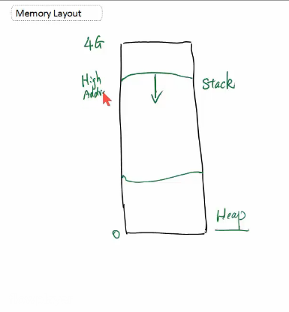
RAM
Stack
very fast access
don't have to explicitly de-allocate variables
space is managed efficiently by CPU, memory will not become fragmented
local variables only
limit on stack size (OS-dependent)
variables cannot be resized
Heap
variables can be accessed globally
no limit on memory size
(relatively) slower access
no guaranteed efficient use of space, memory may become fragmented over time as blocks of memory are allocated, then freed
you must manage memory (you're in charge of allocating and freeing variables)
variables can be resized using realloc()
http://gribblelab.org/CBootcamp/7_Memory_Stack_vs_Heap.html

Slide 5
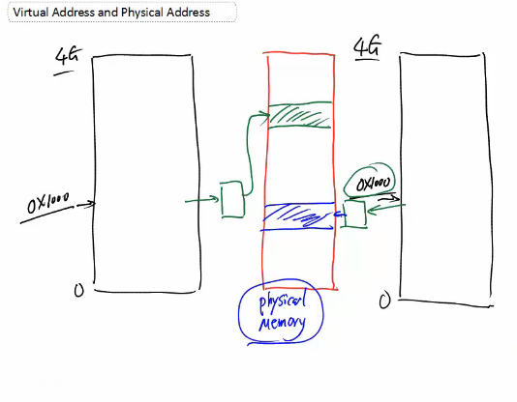

Slide 6
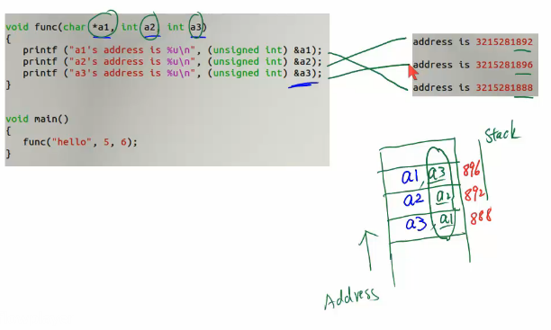

Slide 7
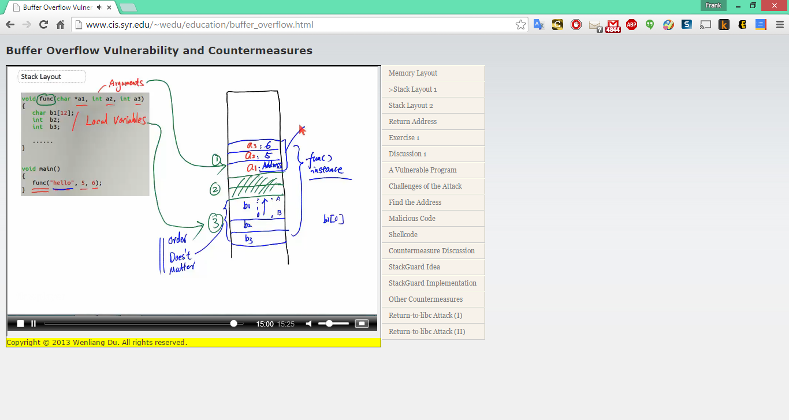

Slide 9
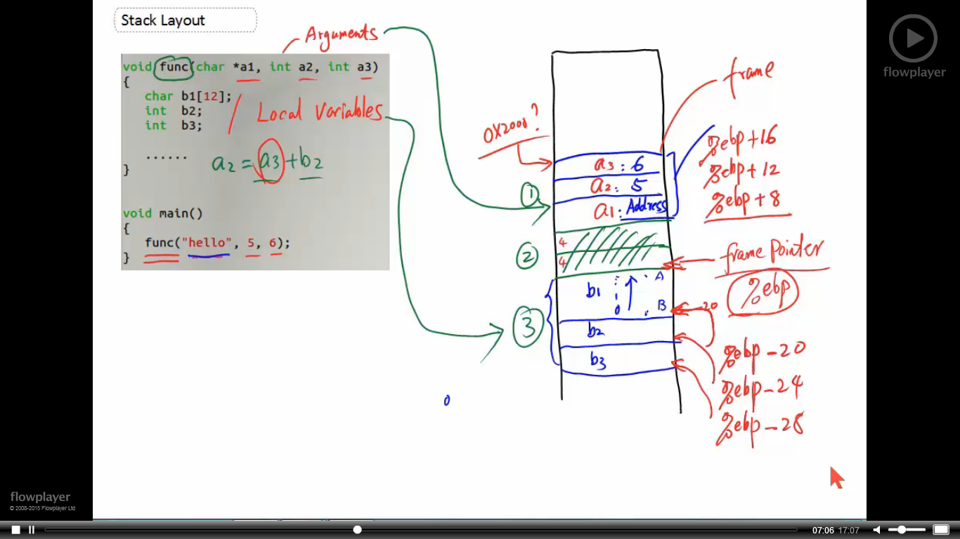
How to Access Address Using Frame Pointer
How to get the a3 value at run time?
Need the memory address of a3
Use %ebp as a base (relative) address
Aka, frame point

Slide 10
How to Access Address Using Frame Pointer
%ebp points to the current frame point

Slide 11
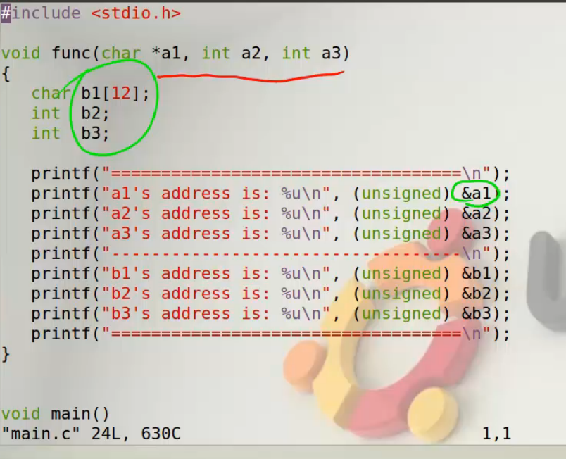

Slide 12
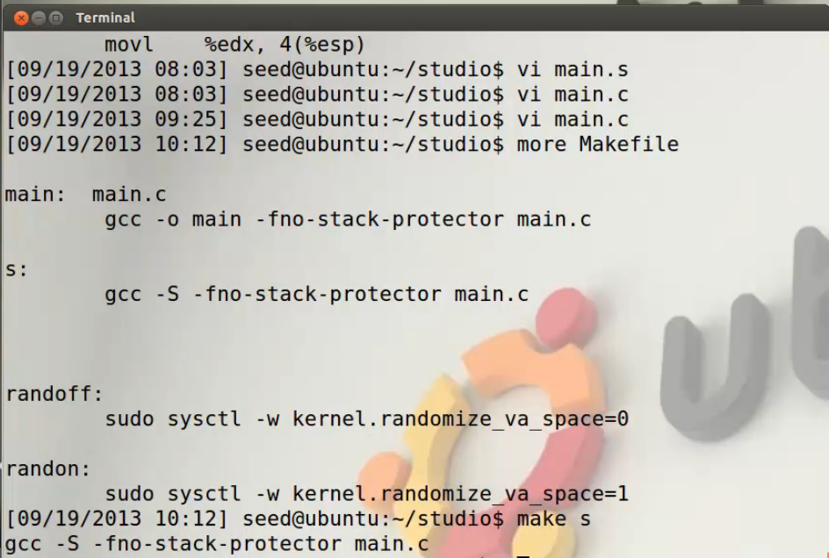

Slide 13
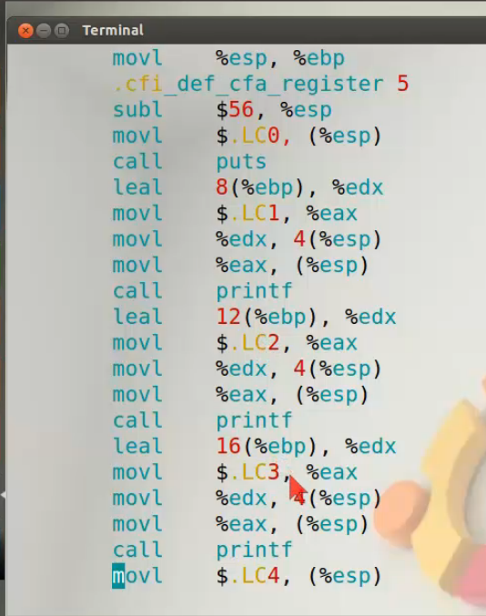
a1
a2
a3

Slide 14


Slide 15
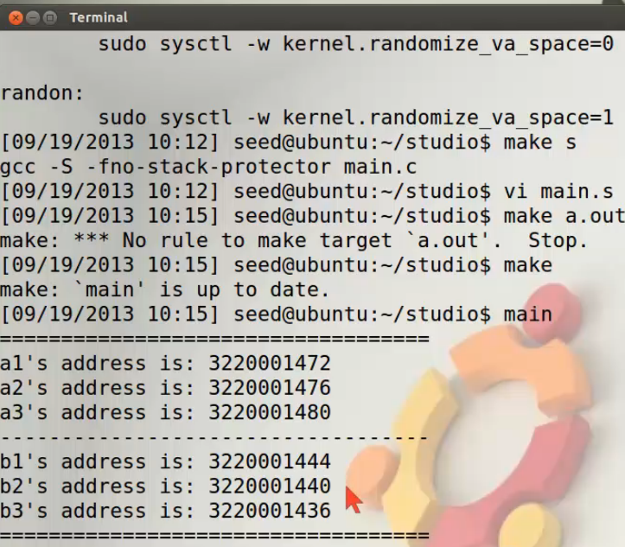

Slide 16
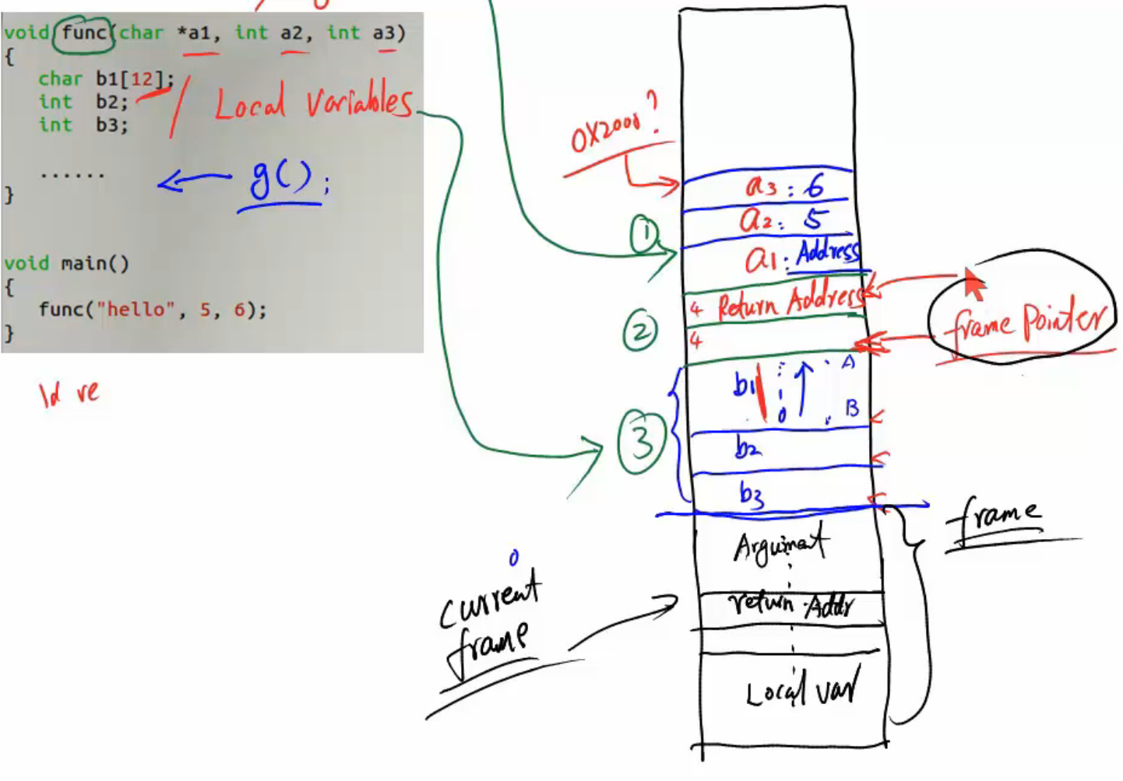
Return Address & Function Call

Slide 17
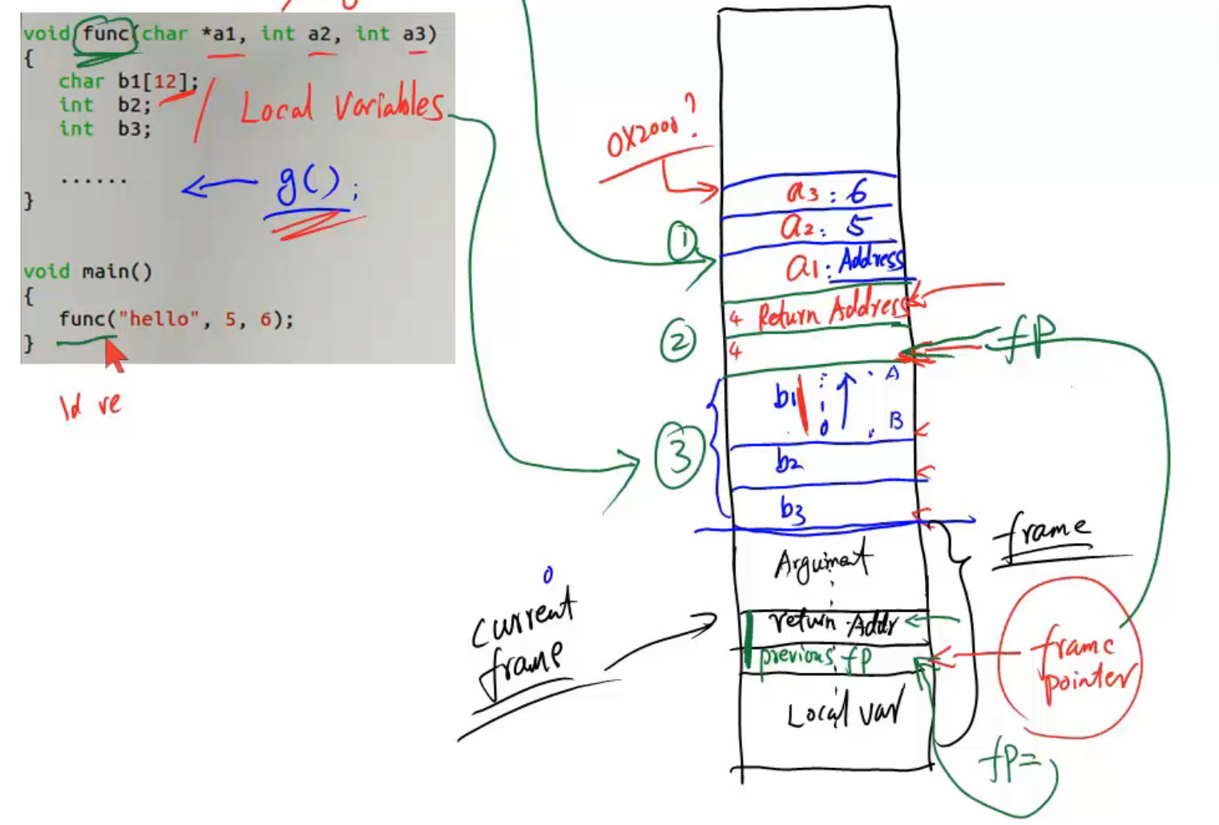
Frame Pointer

Slide 18
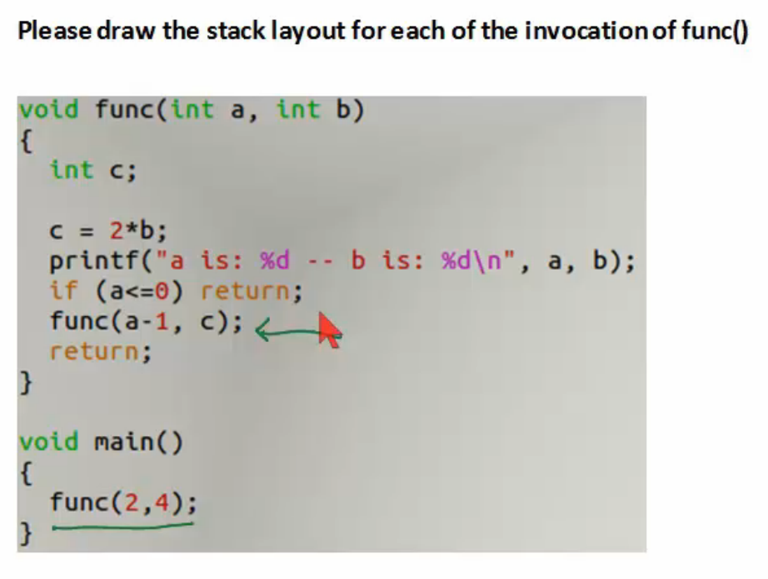

Slide 19
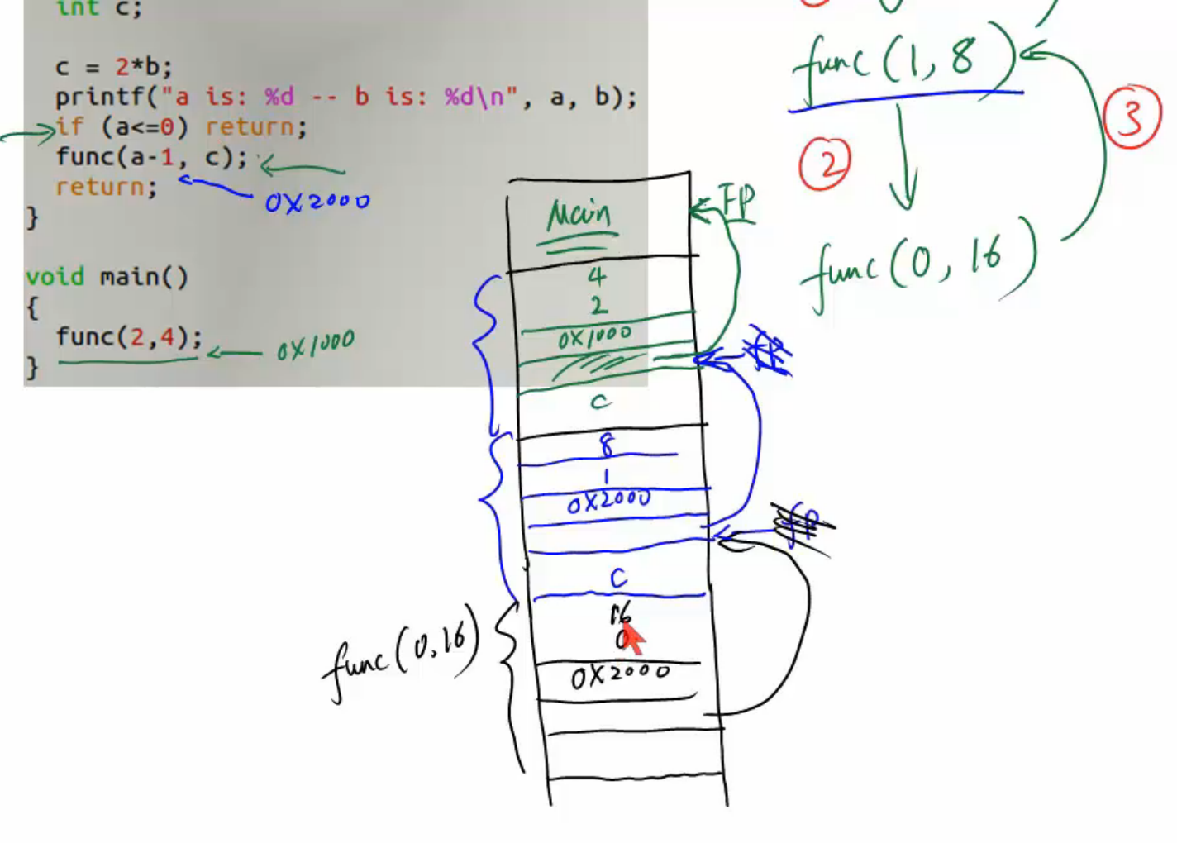

Slide 20
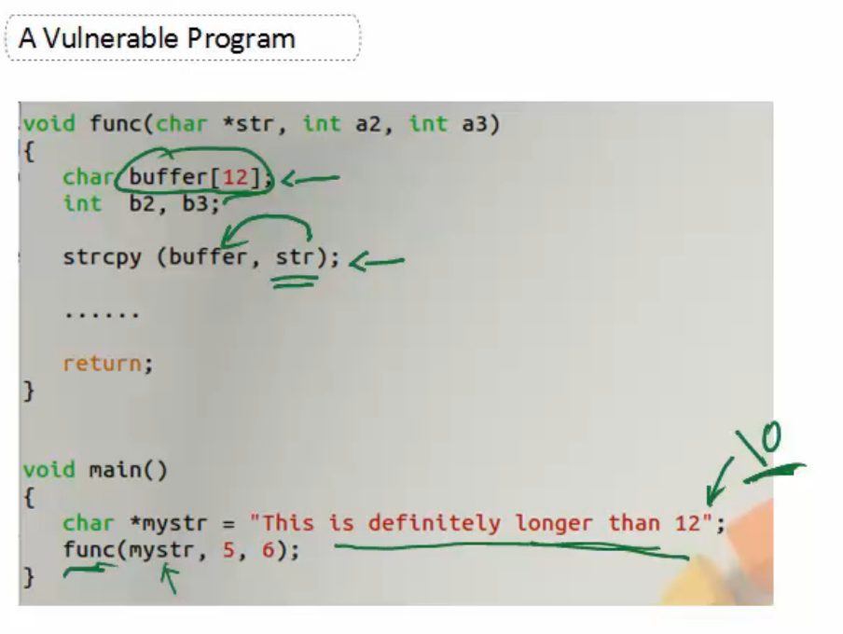

Slide 21
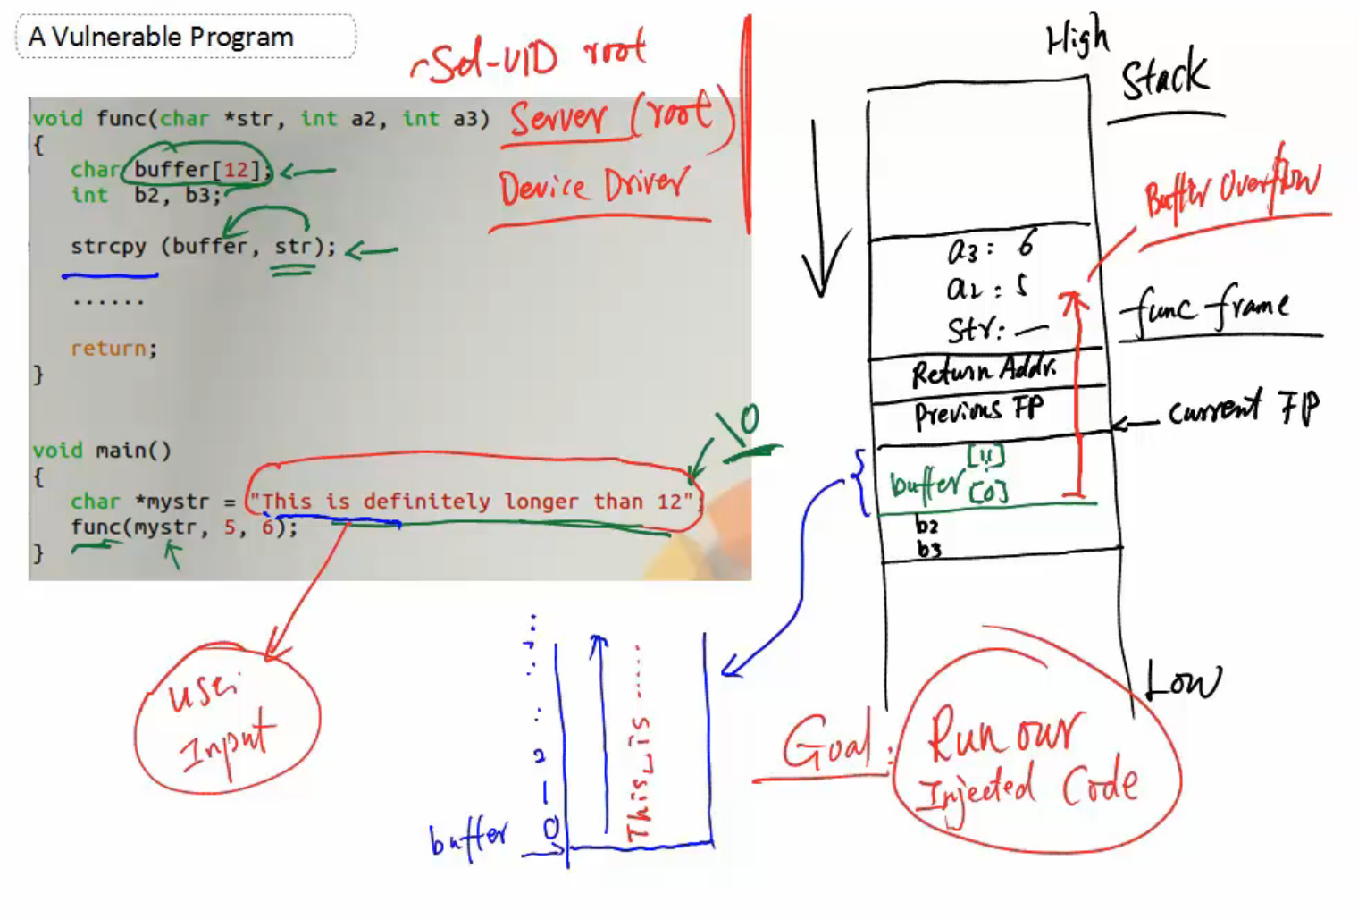

Slide 22
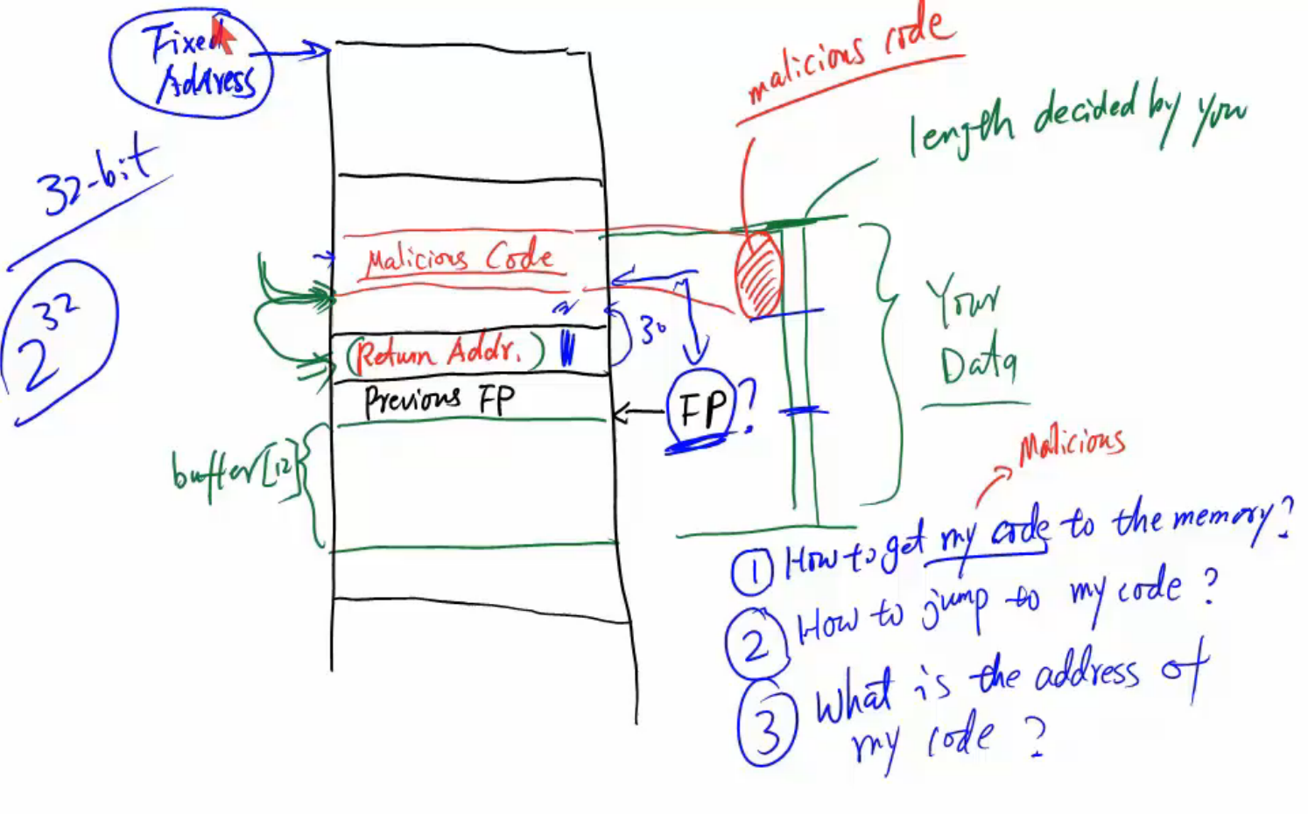
Challenges of Attack

Slide 23
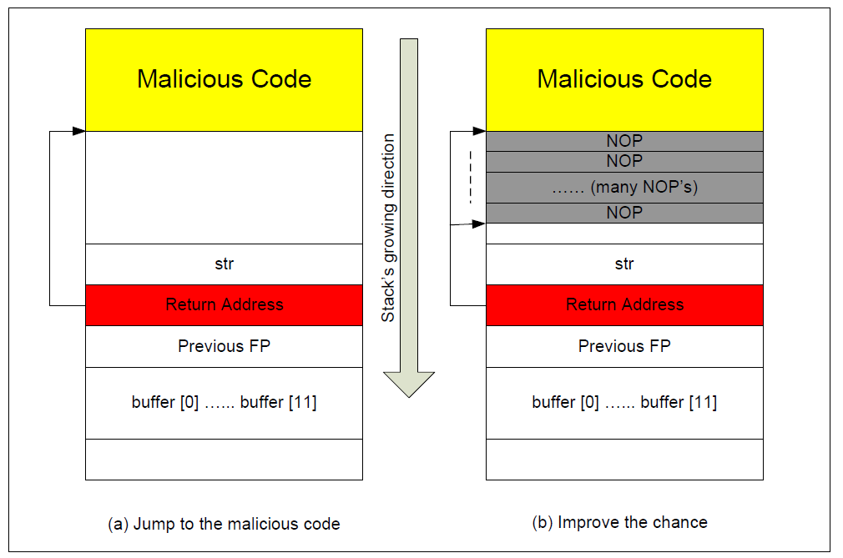
How to Jumping to the Malicious Code
assume that the malicious code is in memory

Slide 24
Find Return Address
If the target program is a Set-UID program, you can make a copy of this program, and run it with your own privilege;
this way you can debug the program
note that you cannot debug a Set-UID program.
In the debugger, you can figure out the address of buffer[], and thus calculate the starting point of the malicious code.
The address of buffer[] may be slightly different when you run the Set-UID copy, instead of your copy, but you should be quite close.
You can try several values.

Slide 25
If the target program is running remotely
However, you can always guess.
The following facts make guessing a quite feasible approach:
Stack usually starts at the same address.
Stack is usually not very deep: most programs do not push more than a few hundred or a few thousand bytes into the stack at any one time.
Therefore the range of addresses that we need to guess is actually quite small.

Slide 26
Improving the chance
We can add many NOP operations to the beginning of the malicious code.
NOP is a special instruction that does nothing other than advancing to the next instruction.
Therefore, as long as the guessed address points to one of the NOPs, the attack will be successful.
With NOPs, the chance of guessing the correct entry point to the malicious code is significantly improved.

Slide 27
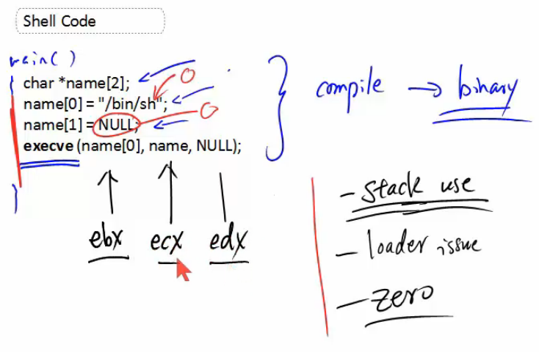

Slide 28
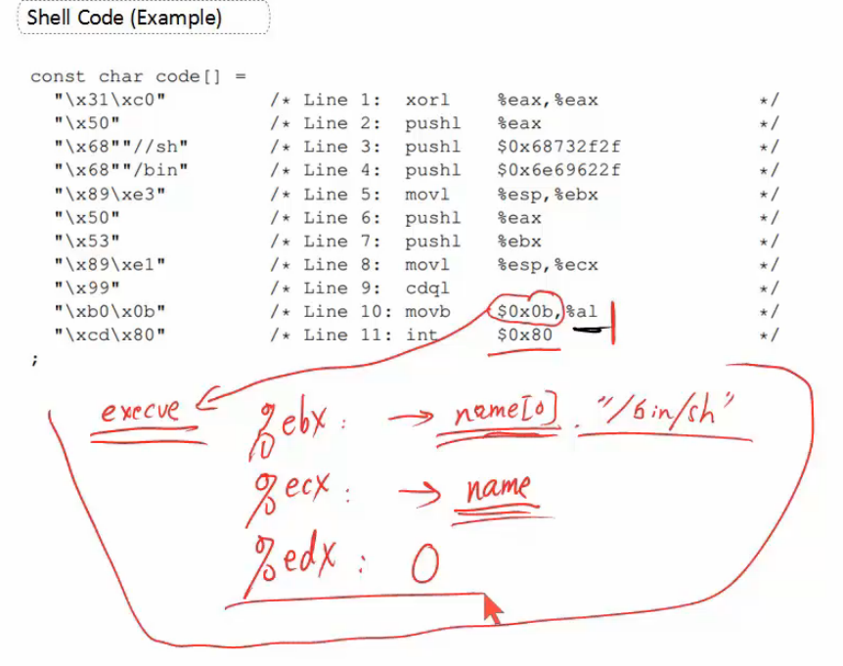

Slide 29
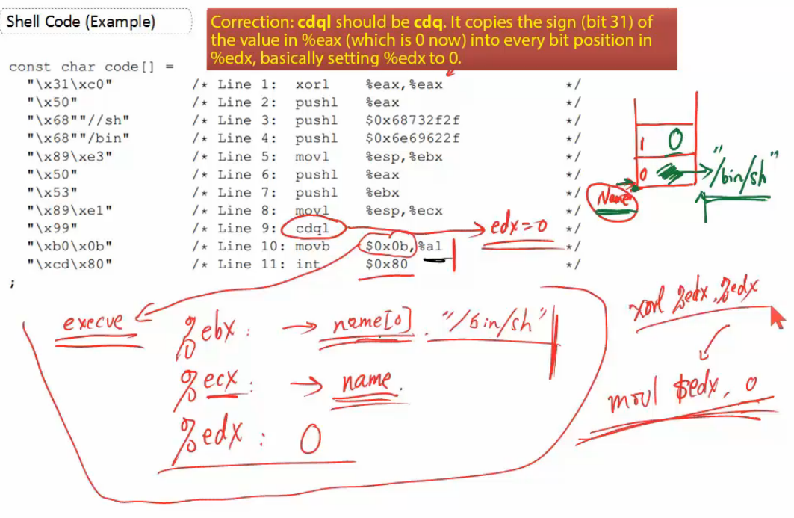
%edx = 0

Slide 30
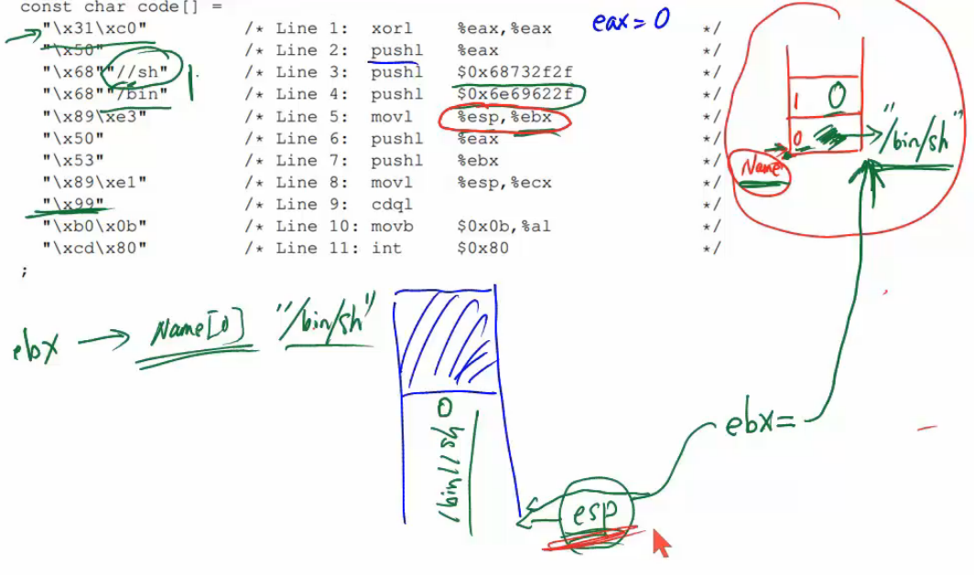
%ebx -> Name[0] #/bin/sh
The ESP register serves as an indirect memory operand pointing to the top of the stack at any time.

Slide 31
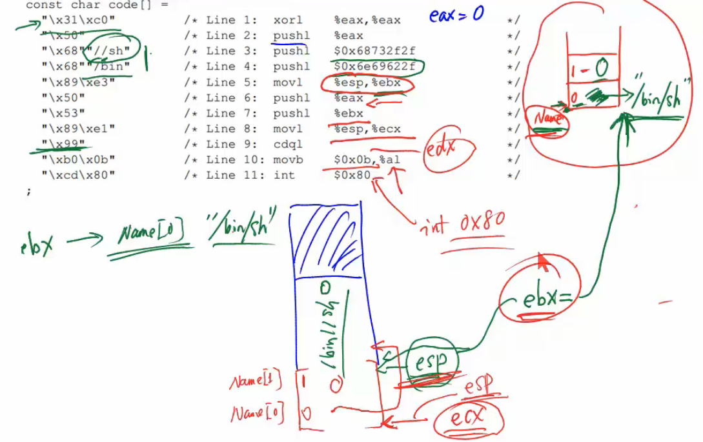
%ecx->name

Slide 32
Lab
Go through the lab instructions

Slide 33
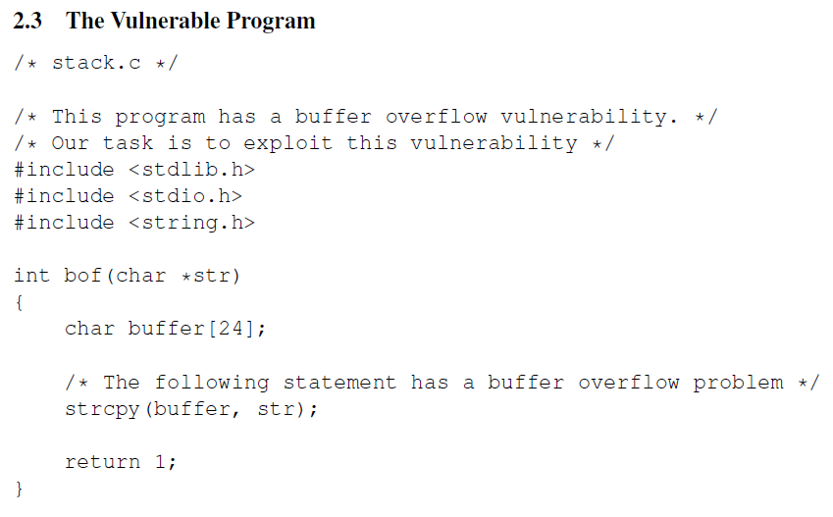
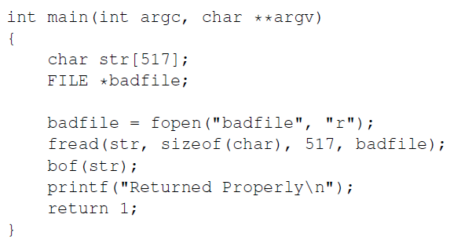
Goal: Generate the badfile

Slide 34
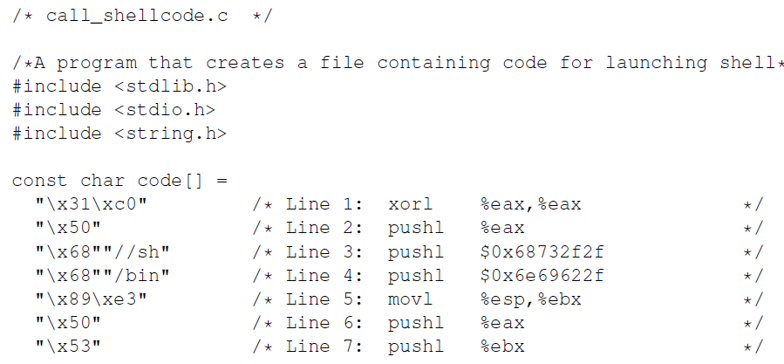
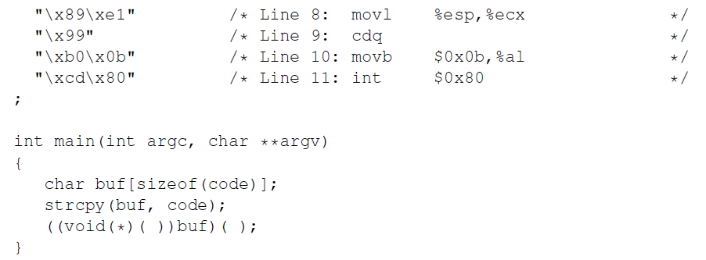

Slide 35
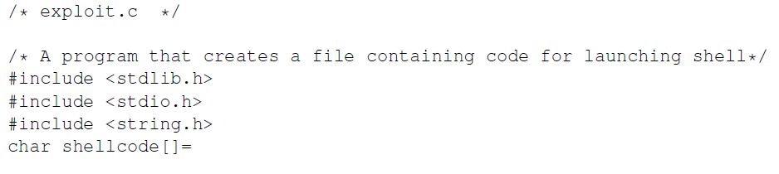
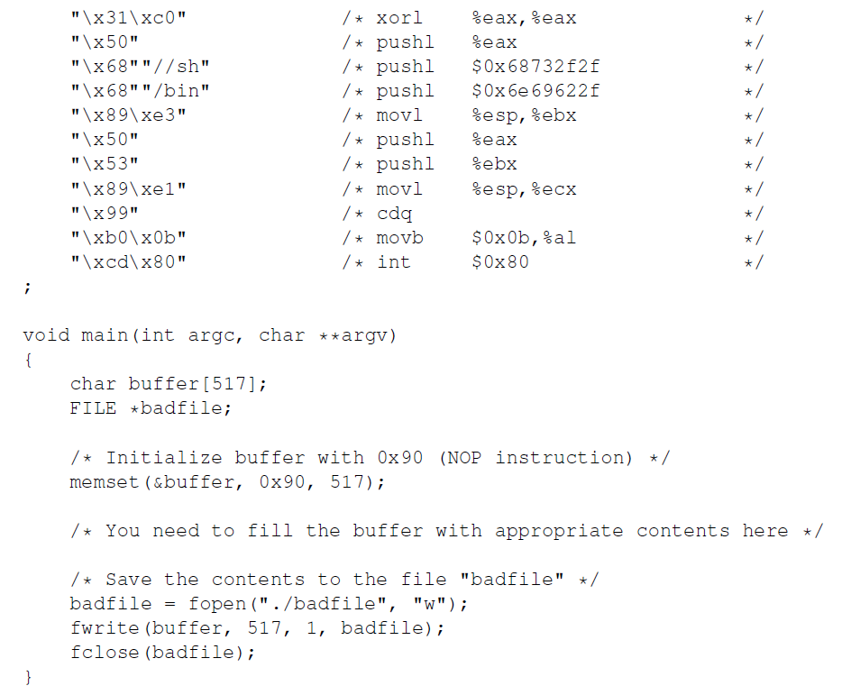
You have to modify this to generate badfile

Slide 36
Find Address of buffer[24] and Frame Pointer (ebp) in bof
$gcc -z execstack –g –o stack_dbg stack.c #use debug flag to compile stack.c
$touch badfile # create a file named badfile
$dbg stack_gbg # use debugger to find buffer address (assume 0xbfff138)
and ebp (assume 0xbfff158)
Return address 0xbfff138+0x20+0x4 (32 bits address of previous FP)
Frame Pointer 0xbfff158
0x20 bytes (size varies)
Buffer address 0xbfff138

Slide 37
The content of the address = the start of malicious code
0xbfff138+0x20+0x4 +0x4 (the return address itself has 4 bytes)=
0xbfff160
Notes: we can pick up a higher value, say 0xbfff260
Return address 0xbfff138+0x20+0x4 (32 bits address of previous FP)
Frame Pointer 0xbfff158 %ebp
0x20 bytes (the size varies)
Buffer address 0xbfff138

Slide 38
Size of shellcode
Put the shell code from here
Size of buffer 517
Buffer address 0xbfff138
Buffer address +sizeof(buffer)-sizeof(shellcode)

Slide 39
Solution pseudo code for creating the badfile
main(){
…
//place return address
*((long *) buffer+0x24))= 0xbfff260
// place the shell code towards the end of the buffer
Memcpy(buffer+sizeof(buffer)-sizeof(shellcode), shellcode, sizeof(shellcode);
…
}

